Slide 1
Documenting Ligament Laxity and Spinal Impairment Using The AMA Guides
Raymond Wiegand, D.C.
SpineMetrics , Inc.

Slide 2
What is Ligament Laxity?
Ligament laxity is a loss of functional stability between two adjacent vertebra.
It is described in the AMA Guides to the Evaluation of Permanent Impairment, 3rd, 4th, 5th and 6th Editions
It is an objective finding based not on opinion but on mathematical modeling.
When identified it represents a 25-28% whole body impairment.

Slide 3
Is Ligament Laxity a Common Finding in Sudden Impact Injuries?
In a sample of 588 patients involved in sudden impact injuries 65% demonstrated one level of ratable impairment.
26% demonstrated two or more levels of ligament instability.

Slide 4
What Does AOMSI Mean to the Patient
(Alteration of Motion Segment Integrity)
Ligament laxity identifies a patho-kinematic abnormality that alerts a doctor to use precautionary treatment procedures
In some instances surgical intervention may be required to stabilize the motion segment
It informs the patient as to the current extent of injury and to potential future consequences
It provides the treating doctor a biomechanically accurate diagnosis to create a long-term treatment plan to ensure stabilty
When litigation is involved it objectively identifies injury independently of a positive or negative MRI. It creates the opportunity for fair and equitable settlements based upon insurance carrier algorithms.

Slide 5
Why is Functional Stability Important?
The spine is a multi-component semi-rigid elastic structure
  Semi-rigid is an engineering term describing the nature and properties of a single material or the behavior of a system of mixed materials.
The spinal column is a system of mixed materials consisting of alternating rigid vertebra and interconnected by elastic ligaments.
In a sequential and alternating combination, the vertebra and ligaments transmit forces and limit motion while sharing and minimizing forces imposed on the system .

Slide 6
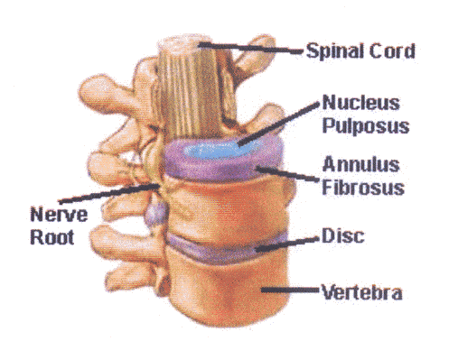
The Anatomy of the Motion Segment
The term motion segment is used to define the smallest functional unit of the spine.
The motion segment includes any two adjacent vertebra and the inter-connecting ligaments
The range and direction of each vertebral motion unit is dictated by the shape of the joint articulation
The ligaments strength, elasticity and integrity confine joint motion to protect the biomechanical stability of each vertebral unit

Slide 7
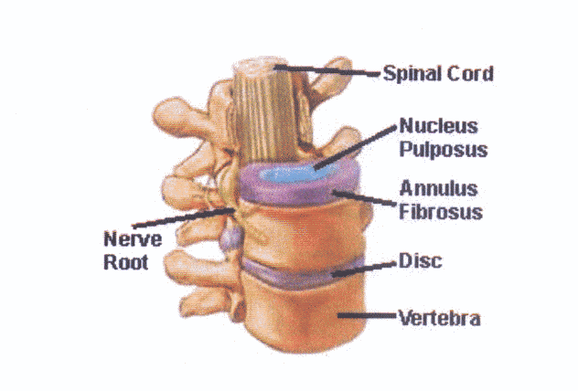
Motion Segment Anatomy: Primary Structures
The vertebra are inter-connected by the strongest ligaments in the body, the strongest are the discs
The primary role of the disc is to transfer forces and motions through the spine
The disc attaches to the top and bottom of each vertebra across the whole surface area of the vertebra. The disc never slips
The disc provides continuity of the vertebra to function as a continuous structure

Slide 8
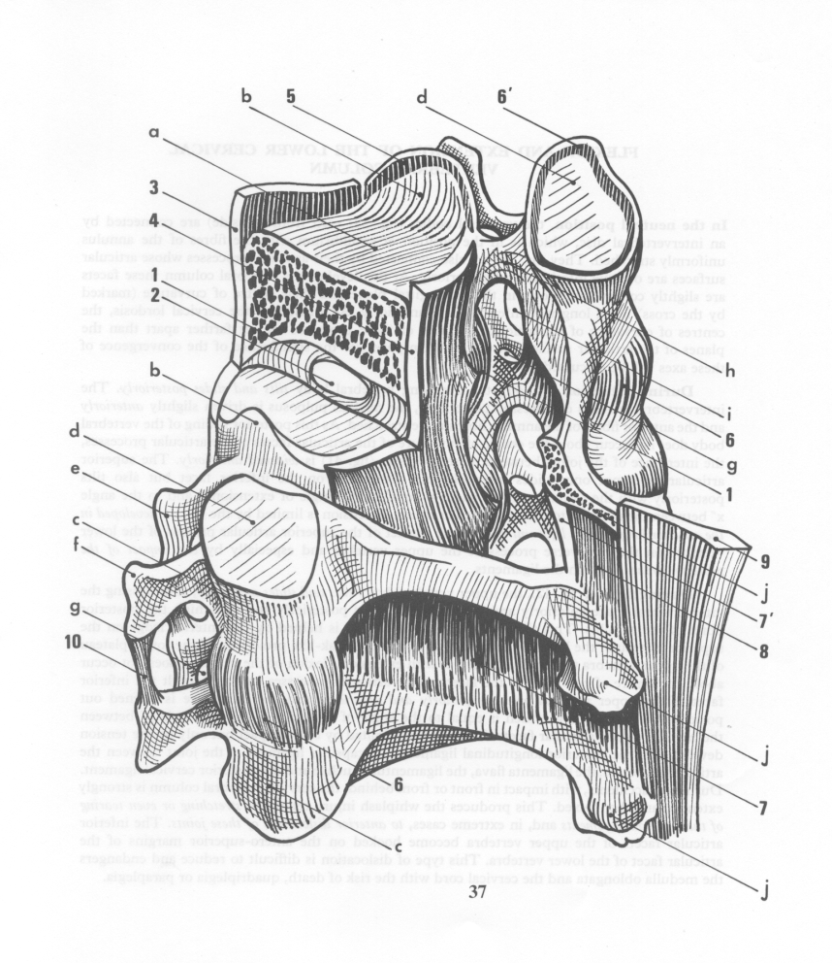
Surrounding Ligaments: Secondary Structures
Each vertebra is surrounded by seven common ligaments
  Anterior longitudinal
  Posterior longitudinal
  Ligamenta flava
  Inter-spinous
  Supra-spinous
  6-7. Two (2) inter-transverse
Any and every motion engages multiple ligaments into a resistive state

Slide 9
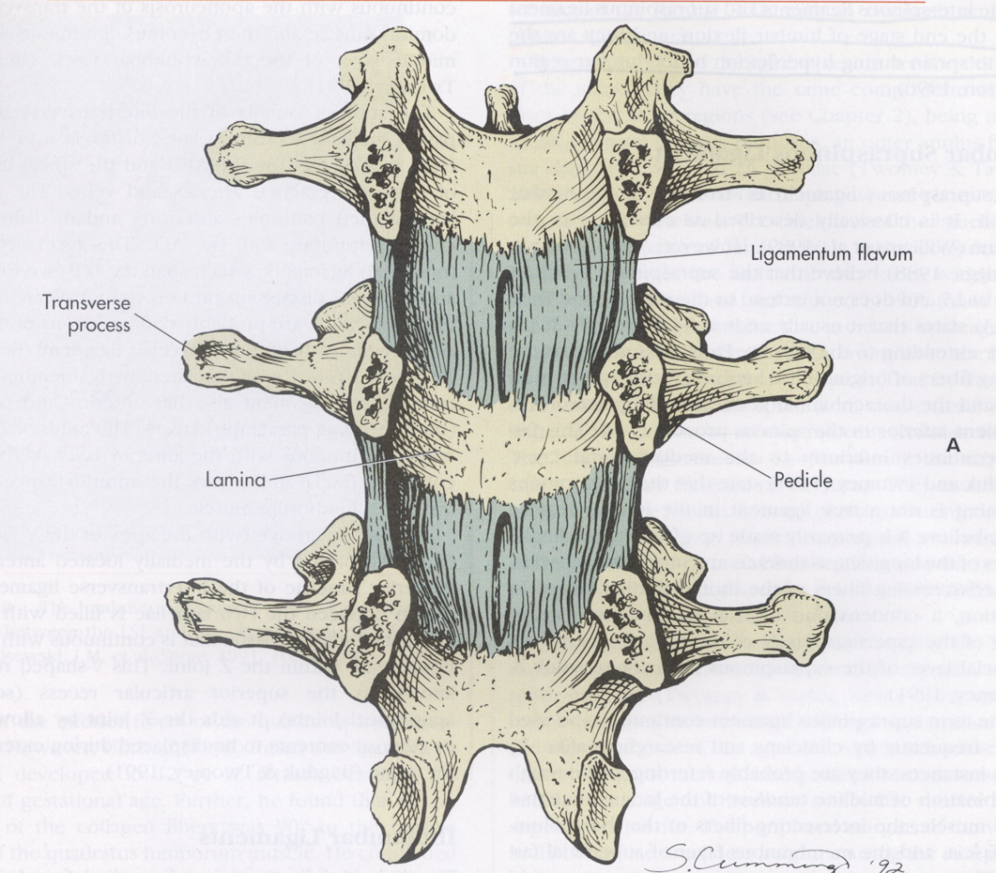
Ligamentum Flavum
The ligamentum Flavum illustrates the completeness of an intact ligament system to confine and restrict motion from one vertebra to another

Slide 10
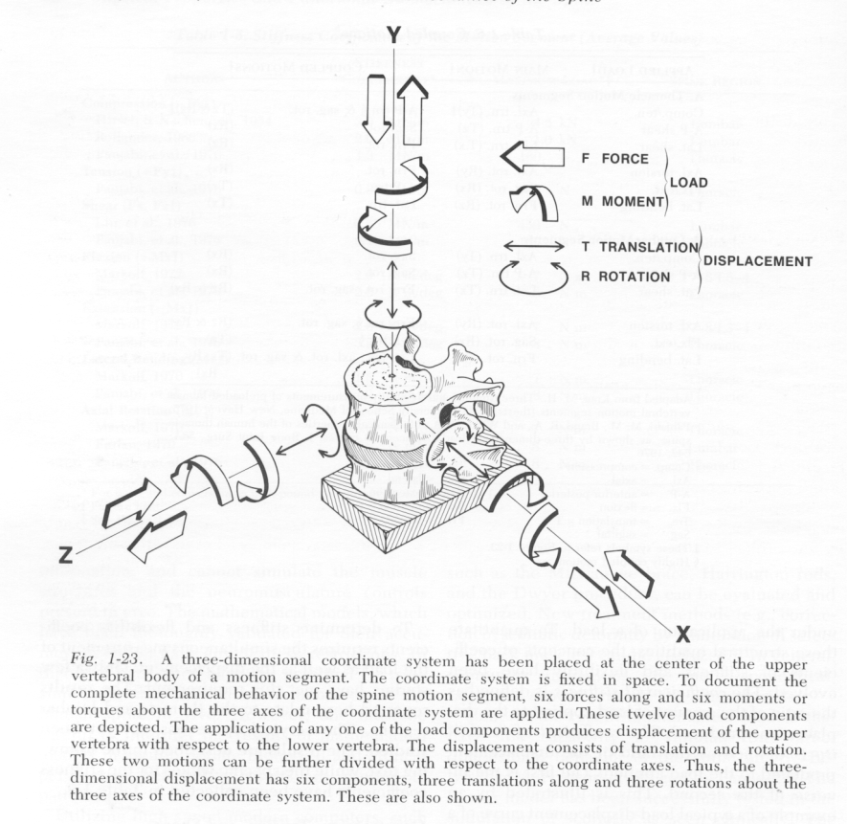
Range of Motions
Range of motions are determined by joint design and constrained by ligaments
As a range of motion is increased in any direction it engages multiple ligaments that when stretched, become more rigid and resistant. The resistive force is oriented to pull the vertebra back to its original neutral position
When a vertebra reaches an endpoint range of motion it is fully confined by the strength and elasticity of the ligaments

Slide 11
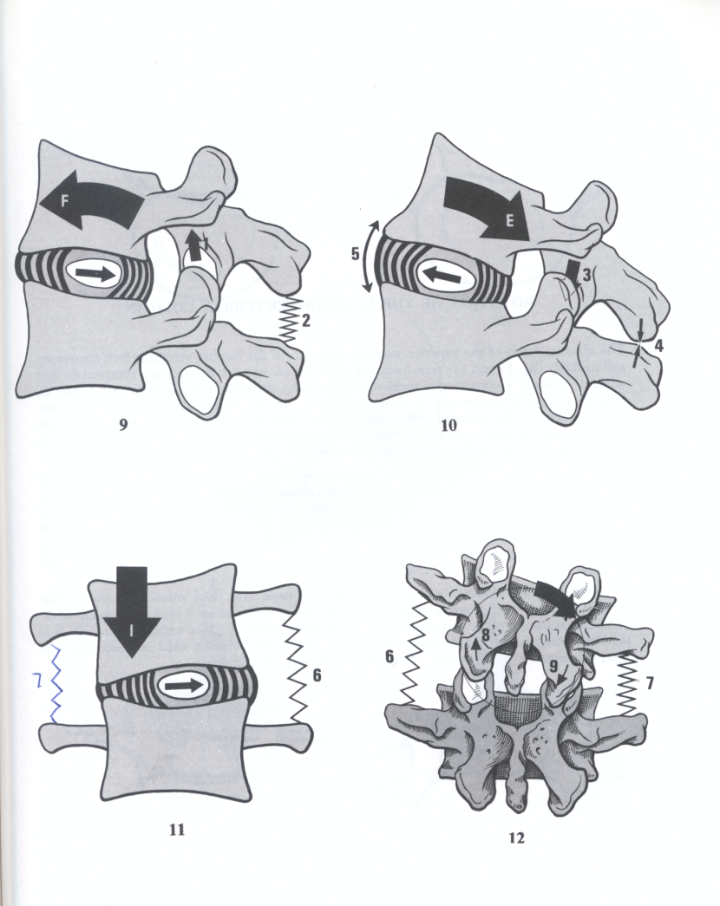
Structural Design and Elastic Properties Likened to a System of Springs and Levers
The spinal joint is formed by the articulation of two vertebra at the facet joints. The facet acts as a central pivot.
During flexion the vertebral bodies approximate while the posterior elements (spinous processes) separate. The facet joints slides on one another as the vertebra pivots
All motions of the vertebra are confined by the inter-connecting ligaments

Slide 12
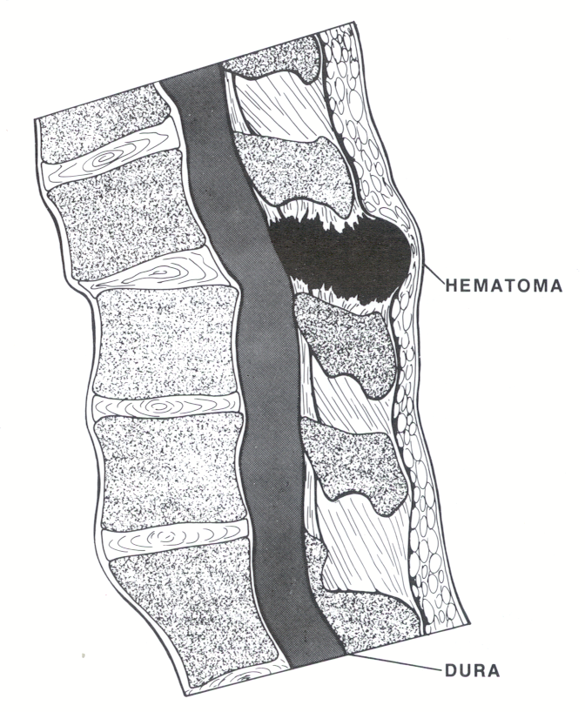
Injury and Loss of Motion Segment Integrity: Flexion Injury
During a sudden impact injury (when stopped) the vertebra suddenly accelerates or decelerates in 10 msec.
This suddenness overcomes the elastic strength of the ligament. The ligament at first yields (i.e.) stretches to such an extent that it can not return to its original shape
  This is due to internal disruption of the ligament tissue (tertiary strain/sprain a.k.a. tearing)
This is followed by complete structural or functional failure of the ligament

Slide 13
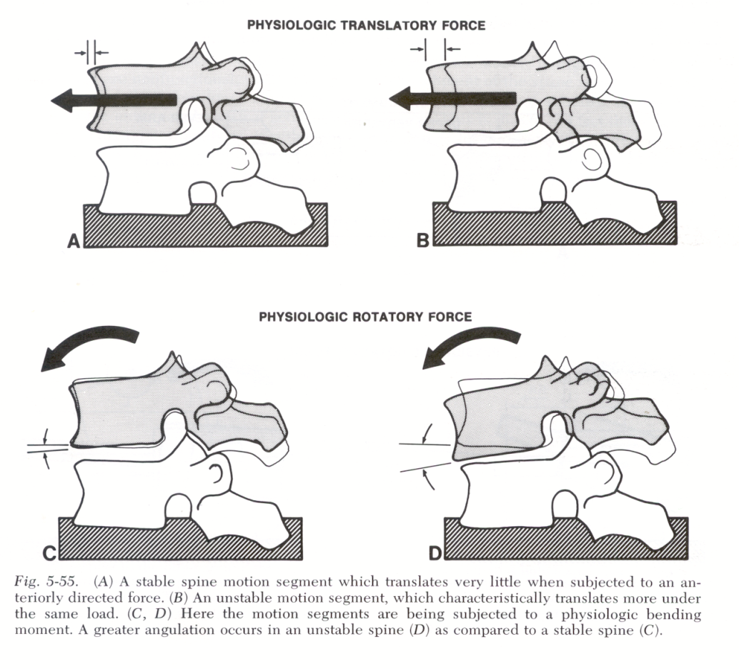
Ligament Injury Compromises the Integrity of the Motion Segment
Depending on the direction of the force/s and the ligament/s damaged, the motion segment is no longer restrained within its normal ranges of motion
Hypermobility in rotation and translation are the first consequences followed by abnormal wear or degeneration with aberrant neurological sequella either localized or radiating

Slide 14
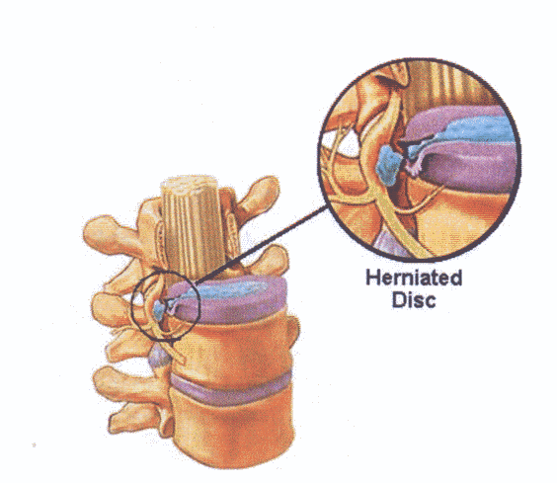
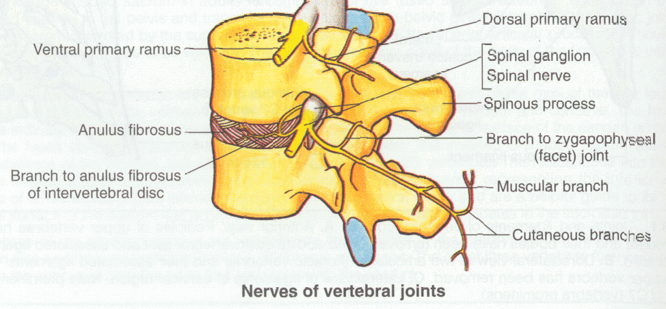
Consequences of Ligament Laxity
Irritation to the nerve from disc herniation is easy to understand. Direct pressure or irritation to the nerve root.
Ligament laxity is more subtle and complicated because it includes aberrant joint motion and aberrant joint loading. Both of which over time will produce irritation to the innervating nervous tissue to all adjacent tissues (joint capsules, mechanoreceptors, etc…)
As normal joint alignment and loading is compromised functional stenosis occurs along with structural degeneration.
A viscous cycle of destabilization, and overload continues driven by gravity and normal activities.

Slide 15
Measuring Method used to Determine Ligament Instability and Alteration of Motion Segment Integrity (AOMSI)
The AMA Guides to the Evaluation of Permanent Impairment, 3rd, 4th ,5th and 6th editions have described the measurement method to determine ligament instability (CPT 728.4) as far back as the 1980’s.
The method involves measuring the rotation and translation of the vertebra from a cervical or lumbar radiograph (x-ray) in the flexion and extension positions.
When the range of motion of adjacent motion segments differs by 11 degrees or greater it is classified as AOMSI . This is a direct consequence of a loss of ligament integrity.
When translation of any motion segment exceeds 3.5 millimeters in the cervical region it is classified as AOMSI.
When translation of any motion segment exceeds 4.5 millimeters in the lumbar regions it is classified as AOMSI.

Slide 16
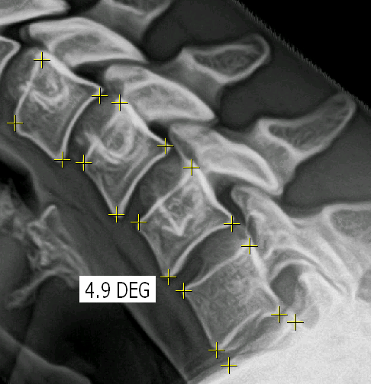
Procedure for Measuring AOMSI
The four corners of each vertebra are identified to calculate the disc angle for each motion segment
The range of motion of each motion segment is calculated by taking the difference of the flexion and extension disc angles

Slide 17
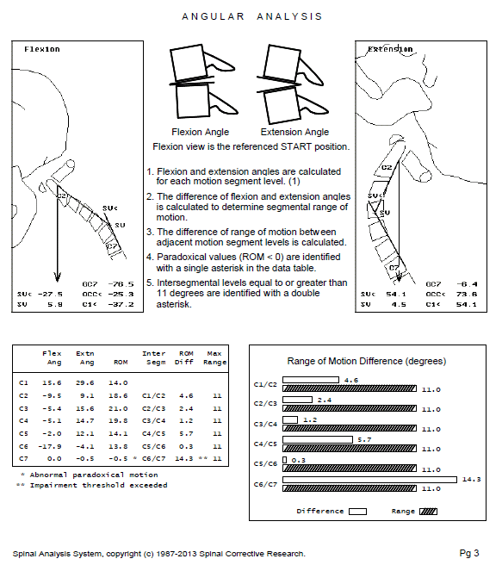
Determining Impairment: Angular Analysis
The spinal geometry and disc angle range of motion are calculated and displayed in tabular and graphical formats. The results are compared to the threshold values as defined by the GUIDES.

Slide 18
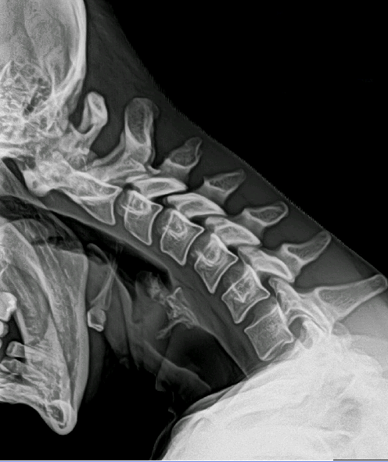
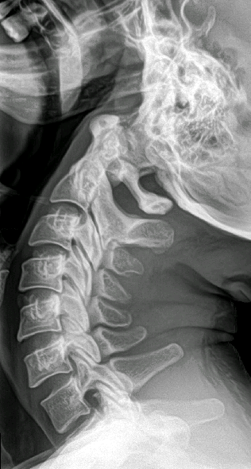
Measuring the Difference of Range of Motion
The range of motion is determined for each motion segment
The difference of each adjacent segment range of motion is calculated.
In this example the difference of C5 to C6 is 15.8⁰. The impairment threshold of 11⁰ is exceeded and the patient qualifies for a 25% whole body impairment
 | ROM F / E | DIFF | IMPAIR ≥ 11⁰
C1 | 5.7
C2 | 9.5 | 3.8
C3 | 12.6 | 3.1
C4 | 13.1 | 0.5
C5 | 17.7 | 4.6
C6 | 1.9 | 15.8 | **
C7 | -5.5 | 7.4

Slide 19
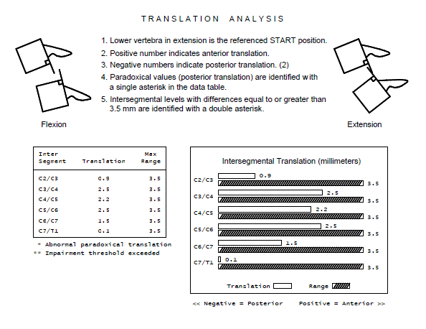
Determining Impairment: Translation Analysis
The translation (front to back movement) of each vertebra is calculated and displayed. In the cervical region, translation equal to or greater than 3.5 mm qualifies for a 25% whole body impairment .
In the lumbar region translation equal to or greater than 4.5 mm qualifies for a 25% whole body impairment.

Slide 20
When is testing for AOMSI Appropriate
ANY patient involved in a sudden impact injury should be tested for AOMSI
This includes but not limited to
  Automotive accidents of any kind at any impact velocity
  Sports injuries where concussion is suspect
  Forceful falls
  Forceful acceleration or deceleration incidences where neck or low back pain are involved
Clinical Criteria: Loss of range of motion and pain as sequella to trauma

Slide 21
Where and How do I get AOMSI Testing
The patient’s doctor can order the necessary x-ray studies
The doctor can contact Spine Metrics, Inc. to complete the testing
Spine Metrics can be contacted at
636-329-8774 or www.spinemetrics.us
email smsubmitfiles@gmail.com
Ask for Dr. Raymond Wiegand

